Slide 1
Week 8 Video 5
Conclusions and Future Directions

Slide 2
Whew…
It’s been a long semester
We’ve laughed
We’ve cried
We’ve analyzed data

Slide 3
We’ve discussed
Key EDM/LA methods
And how they can be used
To promote
New scientific discoveries & to advance learning sciences
Better assessment of learners along multiple dimensions
Better real-time support for learners

Slide 4
Lots of Methods
There are a lot of methods for exploring the big data now available in education
We’ve gone through most of the ones that are currently most prominent
But this is always changing

Slide 5
To see what’s most prominent next year
Follow the EDM and LAK conferences and journals

Slide 6
The field of data mining is changing quickly
And sub-areas like educational data mining are changing with it
Some of the new ideas in other areas will eventually transform educational data mining
And some won’t

Slide 7
Final Notes
When there’s a research question, there’s a good analytical or statistical method for it
Occasionally you have to invent it
But make sure to check first for a method that someone (or some research community) has already developed and refined

Slide 8
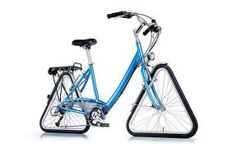

Slide 9
To put it another way

Slide 10
To put it another way
“Anything that’s worth doing is worth doing badly” – Herb Simon
But gosh, it’s even better to do it well
And to be able to determine which way is better

Slide 11
Some potential future directions
More and more constructs will be modeled
Making discovery with models ever more feasible and powerful
The constructs we’re already modeling will be modeled better
The low-hanging fruit will disappear and we’ll move towards the slog that characterizes more mature fields
We’re already seeing this for knowledge inference

Slide 12
Some potential future directions
Validation will become more and more stringent
Educational data will get bigger
Making less conservative methods more feasible
Big educational data will become easier to get

Slide 13
Some potential future directions
We’ll get better at using the results of EDM analyses
Figuring out how to use it to drive more and more sophisticated automated personalization
As well as how to incorporate instructors and other expert humans more effectively into the decision loop
Dashboards
Design

Slide 14
Some potential future directions
Educational inference and prediction will become more and more effective
And the societal questions of how and why we use these methods will become bigger than the technical questions

Slide 15



To learn more
See Data, Analytics, and Learning
Also on EdX

Slide 16
To learn more
Follow @BakerEDMLab on Twitter
Or “Baker EDM Lab” on Facebook
Or come do a Masters in Learning Analytics at Teachers College
Or just come to EDM or LAK!

Slide 17
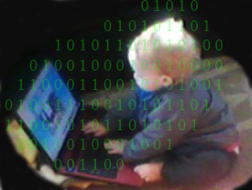
Big Data in Education

